Slide 1

Employee face detection
Python specialization training project

Slide 2
Team:
Gunasri Bollineni-6113
Neelam Rana-6112
Nikitha G Naik-6153
Pratibha Venkatesh-6163
Supraja Chandramouli-6142

Slide 3
Problem Statement:
Given still or video images of the scene, identify or verify one or more persons in the scene using a stored dataset of faces and matching it.

Slide 4
MVC architecture
Face location, size & pose
Aligned Face
Feature Vector
Face detection
Face Alignment
Feature Extraction
Face Matching
image/video
Face ID/Name
Database of Enrolled user

Slide 5
Software used:
Backend:
Python(open CV)
SQL
Frontend:
Html
CSS

Slide 6
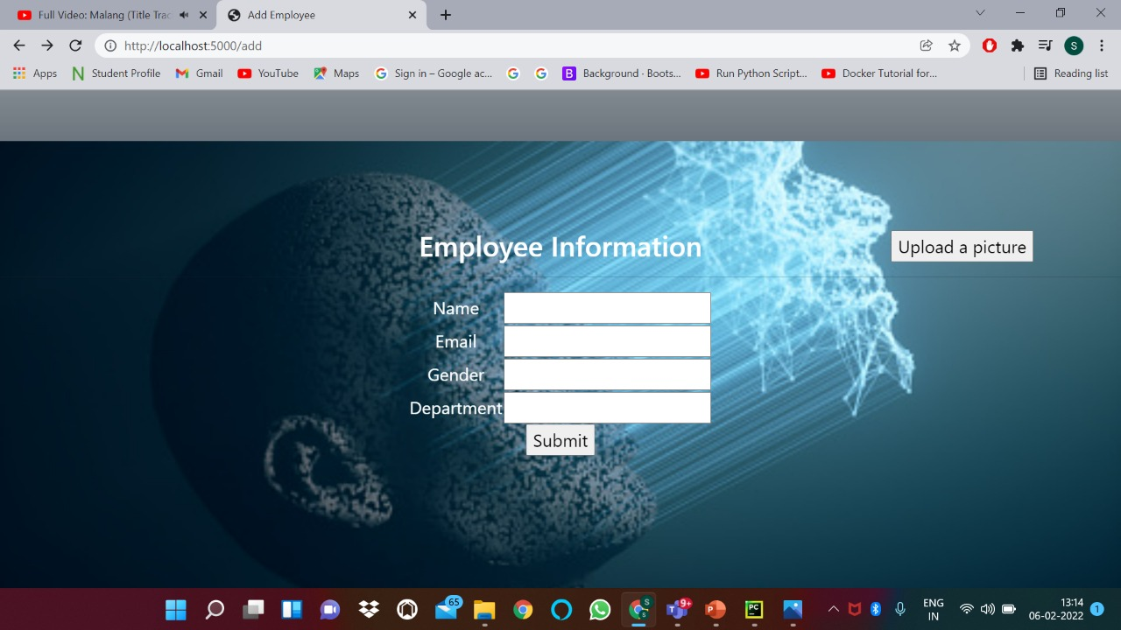
Sample Screenshots of the project:

Slide 7
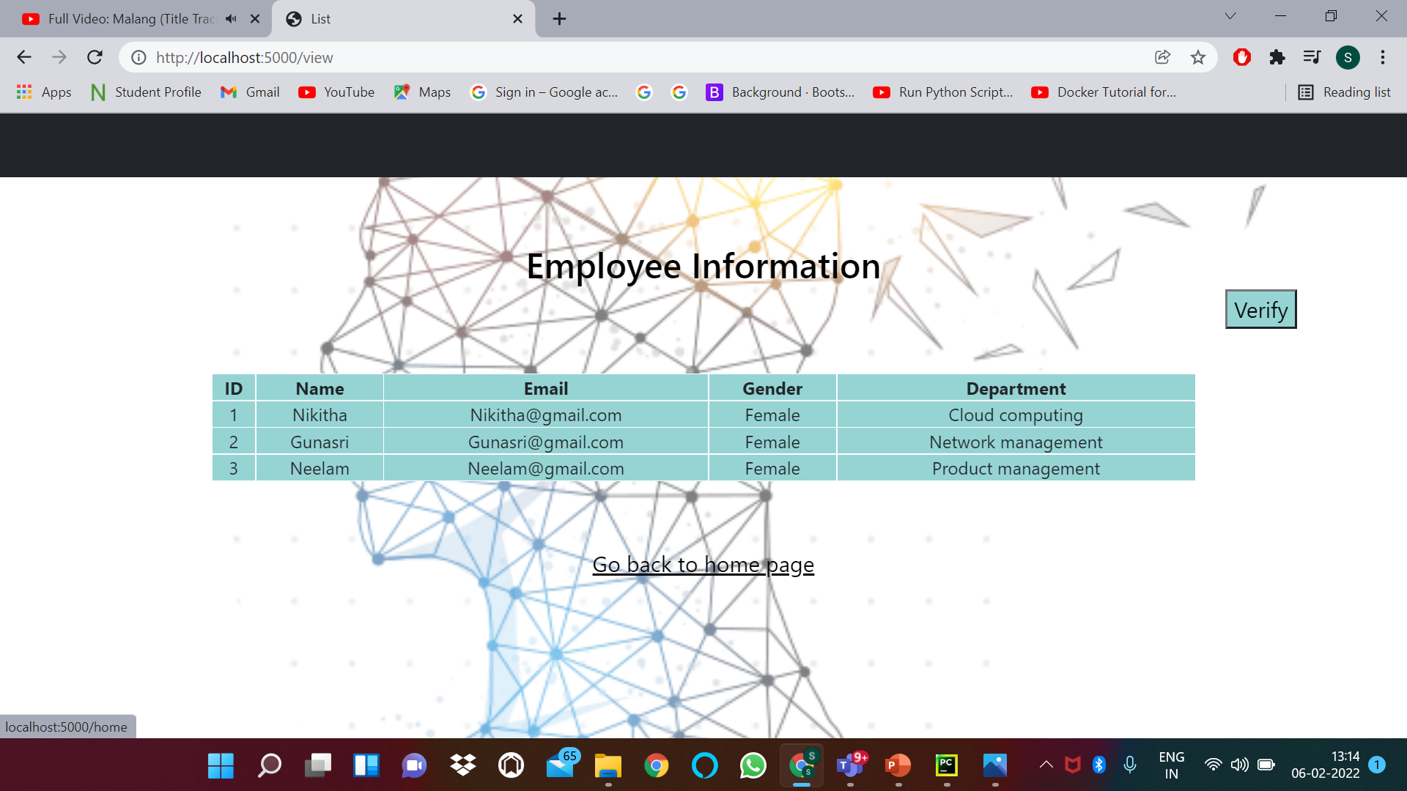
Dataset folder

Slide 8
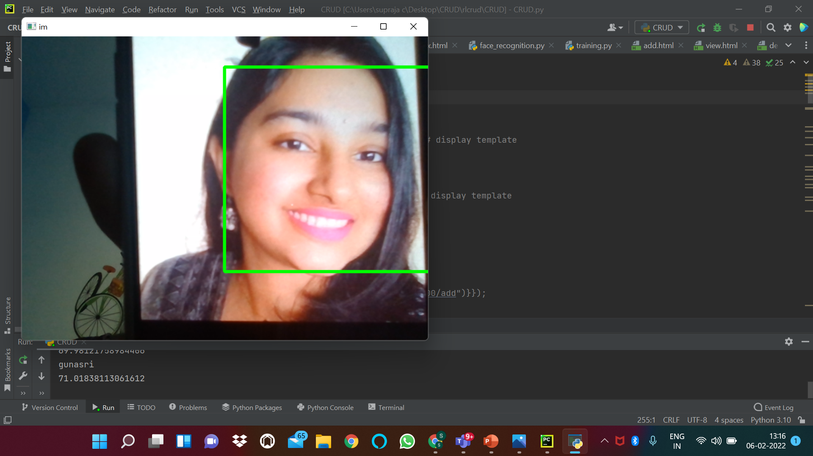
verification

Slide 9
Conclusion:
Face Recognition is an emerging technology that can provide many benefits. Face recognition can save resources and time, and even generate new streams of income, for companies that implement it right.
In this project, we have made use of this Face Recognition system for the purpose of employee face detection and to fetch the data of the same.
Can be used for the attendance purpose in many companies and colleges.

Slide 10
Thank you

